Slide 1


学习汇报 Phone通话总结
蒋响 2024-4-23
Notes:
版权声明：300套精品模板商业授权，请联系【锐旗设计】:https://9ppt.taobao.com，专业PPT老师为你解决所有PPT问题！

Slide 2

Android Telephony
框架结构
01

Slide 3
Android Telephony
框架结构
AP
Telephony的业务应用跨越了AP和BP。AP与BP相互通信。
Android系统在AP上运行，而Telephony运行在用户空间。
Android Telephony共跨越了三层Java Applications、Java Frameworks和User Libraries层，与Android整体构保持一致。
BP SoftWare在BP上运行，主要负责实际的无线通信能力处理。
APPS
Telephony Framworks
HAL
用户空间
Linux内核
BP
Modem
APIs
Drivers
Drivers
其它...
Modem
stacks
其它...

Slide 4
拨号流程总结
02

Slide 5
UI创建与事件处理
1
处理拨号按钮点击事件
DialpadFragment.java->onClick()执行handleDialButtonPressed()
2
检查通话条件，准备显示通话界面
PreCall.java start()执行DialerUtils.startActivityWithErrorToast()
3
发起通话请求
DialerUtils.startActivityWithErrorToast() 调用 placeCallOrMakeToast()
4
准备交给Telecom处理
通话UI的启动过程结束,执行TelecomUtil.placeCall(context, intent)
后续的通话处理交由Telecom系统来完成。

Slide 6
Telecom处理通话意图
MT(收),MO(发)消息处理关键入口，Dialer和TeleService的消息中转站
TelecomUtil.placeCall(..)
获取telecomManager
调用placeall()方法
public static boolean placeCall(Context context, Intent intent) {
...
getTelecomManager(context).placeCall(intent.getData(), intent.getExtras());
...
}
TelecomManager.placeCall()
获取ITelecomService
调用placeCall方法
public void placeCall(Uri address, Bundle extras) {
ITelecomService service = getTelecomService();
service.placeCall();
...
}
实现类TelecomServiceImpl.placeCall()
通过UserCallIntentProcessorFactory
创建UserCallIntentProcessor组件
调用processInt处理呼叫意图
public void placeCall(Uri handle, Bundle extras, String callingPackage,String callingFeatureId) {
mUserCallIntentProcessorFactory.create().processIntent();
}

Slide 7
处理呼叫意图
UserCallIntentProcessor
CallIntentProcessor
执行processIntent()方法
判断是否满足呼叫请求
满足则执行processOutgoingCallIntent()
->执行sendIntentToDestination()
->获取telecomManager并执行其handleCallIntent方法
调用TelecomService.handleCallIntent()
调用CallIntentProcessor.Adapter的processOutgoingCallIntent()方法
通过callManager的startOutgoingCall创建callFuture
创建call->创建NewOutgoingCallIntentBroadcaster
调用其processCall() 广播新的外拨电话意图
private boolean sendIntentToDestination() {
TelecomManager tm = (TelecomManager) mContext.getSystemService(Context.TELECOM_SERVICE);
tm.handleCallIntent(intent, callingPackage);
}
static void processOutgoingCallIntent(...) {
NewOutgoingCallIntentBroadcaster broadcaster =
new NewOutgoingCallIntentBroadcaster(...);
CompletableFuture<Call> callFuture = callsManager
.startOutgoingCall(...);
callFuture.thenAccept((call) -> {
broadcaster.processCall(call, disposition);}
});
}
适配器类：为了统一不同类的接口，使它们能够以统一的方式被调用

Slide 8
处理呼叫意图
NewOutgoingCallIntentBroadcaster
public void processCall() {
if (!callRedirectionWithService) {
callImmediately(disposition);
}
}
private void callImmediately() {
placeOutgoingCallImmediately();
}
private void placeOutgoingCallImmediately(){
mCallsManager.placeOutgoingCall();
}
NewOutgoingCallIntentBroadcaster:processCall()
判断条件，满足则执行CallImmediately
->执行placeOutgoingCallImmediately()
->执行了 CallsManager中的placeOutgoingCall
适配器类：为了统一不同类的接口，使它们能够以统一的方式被调用

Slide 9
CallsManager创建通话连接
CallsManager.placeOutgoingCall方法
通知并调用
Call.java的startCreateConnection()
开始创建通话连接
public void placeOutgoingCall(...){
notifyStartCreateConnection(call);
call.startCreateConnection(mPhoneAccountRegistrar);
}
Call.startCreateConnection()
调用 CreateConnectionProcessor.process()
进行连接创建
void startCreateConnection(PhoneAccountRegistrar phoneAccountRegistrar) {
mCreateConnectionProcessor.process();
}
public void process() {
attemptNextPhoneAccount();
}
CreateConnectionProcessor.java:process()
执行attemptNextPhoneAccount()
选择满足条件的电话账户来进行通话

Slide 10
CallsManager创建通话连接
进入attemptNextPhoneAccount()，
逐个检查每个账号是否满足通话条件，
满足则建立连接服务并调用
ConnectionServiceWrapper的createConnection()
进行创建连接
private void attemptNextPhoneAccount() {
CallAttemptRecord attempt = null;
if (...) {attempt = mAttemptRecordIterator.next();
if (...)attemptNextPhoneAccount();}}
if (mCallResponse != null && attempt != null) {
mCall.setConnectionService(mService);
mService.createConnection(); }
}
public void createConnection() {
BindCallback callback = new BindCallback() {
public void onSuccess() {
mServiceInterface.createConnection()
}
}
进入回调函数，
逐步判断执行IConnectionService的
createConnection()方法
其实现类ConnectionService.java的
createConnection()的方法中
创建了一个MSG_CREATE_CONNECTION的消息对象
handleMessage()-> createConnection(...)->
根据Connection类型来处理创建连接还是来电连接
private void createConnection(...) {
connection = isUnknown ? onCreateUnknownConnection(callManagerAccount, request)
: isIncoming ? onCreateIncomingConnection(callManagerAccount, request)
: onCreateOutgoingConnection(callManagerAccount, request);
}

Slide 11
发起呼叫连接
进入attemptNextPhoneAccount()，
逐个检查每个账号是否满足通话条件，
满足则建立连接服务并调用
ConnectionServiceWrapper的createConnection()
进行创建连接
private void attemptNextPhoneAccount() {
CallAttemptRecord attempt = null;
if (...) {attempt = mAttemptRecordIterator.next();
if (...)attemptNextPhoneAccount();}}
if (mCallResponse != null && attempt != null) {
mCall.setConnectionService(mService);
mService.createConnection(); }
}
public void createConnection() {
BindCallback callback = new BindCallback() {
public void onSuccess() {
mServiceInterface.createConnection()
}
}
进入回调函数，
逐步判断执行IConnectionService的
createConnection()方法
其实现类ConnectionService.java的
createConnection()的方法中
创建了一个MSG_CREATE_CONNECTION的消息对象
handleMessage()-> createConnection(...)->
根据Connection类型来处理创建连接还是来电连接
private void createConnection(...) {
connection = isUnknown ? onCreateUnknownConnection(callManagerAccount, request)
: isIncoming ? onCreateIncomingConnection(callManagerAccount, request)
: onCreateOutgoingConnection(callManagerAccount, request);
}

Slide 12
进入RILJ
TelephonyConnectionService
GsmCdmaPhone->RIL
onCreateOutgoingConnection()返回值为null
寻找重写的方法->TelephonyConnectionService.java:
onCreateOutgoingConnection()
调用本类的placeOutgoingConnection()
->两次重载,调用PhoneInternalInterface.java的接口
即将进入RIL
PhoneInternalInterface.java的实现类
GsmCdmaPhone.java的dial()方法
->调用dialInternal()方法
_>调用GsmCdmaCallTracker.java的dial()
根据Phone类型调用不同的dial,以 dialGsm为例
->调用了命令接口层CommandsInterface(由RIL实现)
->RIL获取RadioVoiceProxy对象，调用dial()
->通过HIDL调用RILC的dial()方法,进入RILC
private void placeOutgoingConnection(){
originalConnection = phone.dial(...);
}
private volatile android.hardware.radio.voice.IRadioVoice mVoiceProxy = null;
public void dial() {
mRadioProxy.dial()
}

Slide 13
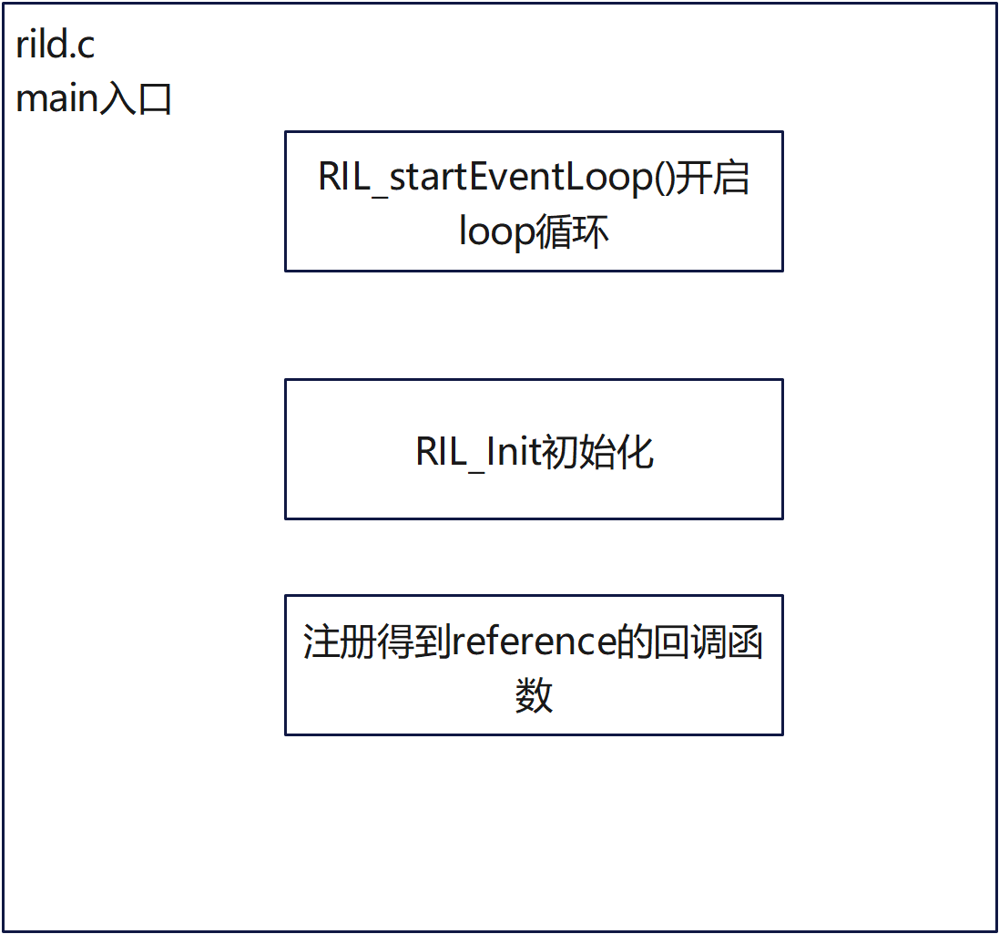
RILC与RILJ交互接口：
hardware/interfaces/radio/aidl/android/hardware/radio/voice/IRadioVoice.aidl
@VintfStability
oneway interface IRadioVoice {void dial(in int serial, in Dial dialInfo);}
RILC执行流程：

Slide 14
RILC执行
Return<void> RadioImpl::dial() {
CALL_ONREQUEST(RIL_REQUEST_DIAL, &dial, sizeOfDial, pRI, mSlotId);
}
对应接口由ril_service.cpp实现
调用了CALL_ONREQUEST()
找到CALL_ONREQUEST()函数定义，它是调用了 s_vendorFunctions->onRequest
#define CALL_ONREQUEST(a, b, c, d, e) s_vendorFunctions->onRequest((a), (b), (c), (d), ((RIL_SOCKET_ID)(e)))
关于其初始化：
它是registerService的一个回调函数
void radio::registerService(RIL_RadioFunctions *callbacks, CommandInfo *commands) {
s_vendorFunctions = callbacks;
}
调用registerService地方是在ril.c的RIL_register
void RIL_register (const RIL_RadioFunctions *callbacks) {
memcpy(&s_callbacks, callbacks, sizeof (RIL_RadioFunctions));//将callbacks放到s_callbacks里
radio::registerService(&s_callbacks, s_commands);
}
调用RIL_register是在rild.c的main函数里
其中s_vendorFunctions就是ril-reference.c的RIL_Init()返回的函数结构体
RIL_RadioFunctions *s_vendorFunctions = NULL;
rilInit =(const RIL_RadioFunctions *(*)(const struct RIL_Env *, int, char **))
dlsym(dlHandle, "RIL_Init");//动态库链接
funcs = rilInit(&s_rilEnv, argc, rilArgv);
RIL_register(funcs);

Slide 15
RILC执行
进入ril-reference.c
找到它最原始的定义和实现：
s_vendorFunctions->onRequest((a), (b), (c), (d), ((RIL_SOCKET_ID)(e)))就是
RIL_RadioFunctions结构体名为onRequest的函数指针
static const RIL_RadioFunctions s_callbacks = {
RIL_VERSION,
onRequest,
currentState,
onSupports,
onCancel,
getVersion
};
const RIL_RadioFunctions *RIL_Init(){return &s_callbacks;
}
onRequet()：
根据请求体类型，进行处理，对应的呼出处理调用的是requestDial()
static void
onRequest ()
{ case RIL_REQUEST_DIAL:
requestDial(data, datalen, t);
break; }
进入requestDial()：
发送at指令：
at_send_command->at_send_command_full
->at_send_command_full_nolock()
->通过writeline发送消息给modem
处理完成的调用
static void requestDial(void *data, size_t datalen __unused, RIL_Token t)
{
RIL_Dial *p_dial;
ret = at_send_command(cmd, NULL);
RIL_onRequestComplete(t, RIL_E_SUCCESS, NULL, 0);
}

Slide 16
RILC执行
requestDial()第二步：
RIL_onRequestComplete处理完成请求回调
static void requestDial()
{
RIL_Dial *p_dial;
ret = at_send_command(cmd, NULL);
RIL_onRequestComplete(t, RIL_E_SUCCESS, NULL, 0);
}
跟进RIL_onRequestComplete：
实际上是s_rilenv中的一个函数指针，在RIL_Init被初始化：s_rilenv = env;
其中env为RIL_Init的一个参数，const struct RIL_Env *env
#define RIL_onRequestComplete(t, e, response, responselen) s_rilenv->OnRequestComplete(t,e, response, responselen)
rild.c RIL_Env：
static struct RIL_Env s_rilEnv = {
RIL_onRequestComplete,
RIL_onUnsolicitedResponse,
RIL_requestTimedCallback,
RIL_onRequestAck
};

Slide 17
RILC执行
ril.cpp RIL_onRequestComplete的实现：
通过checkAndDequeueRequestInfoIfAck
找到对应的RequestInfo结构体（pRI）
通过pRI->pCI->responseFunction
发起response函数调用
RIL_onRequestComplete(RIL_Token t, RIL_Errno e, void *response, size_t responselen) {
pRI = (RequestInfo *)t;
if (!checkAndDequeueRequestInfoIfAck(pRI, false)) {
}
ret = pRI->pCI->responseFunction((int) socket_id,
responseType, pRI->token, e, response, responselen);
}
跟进responseFunction：
是CommandInfo的一个函数指针，在RIL_onRequestComplete中初始化:pRI = (RequestInfo *)t，t为参数
向上追溯，第一次出现是在dial中被初始化
typedef struct CommandInfo {
int requestNumber;
int(*responseFunction) (int slotId, int responseType, int token,
RIL_Errno e, void *response, size_t responselen);
} CommandInfo;
ril_service.cpp dial() 它是addRequestToList的返回值
Return<void> RadioImpl::dial(int32_t serial, const Dial& dialInfo) {
RequestInfo *pRI = android::addRequestToList(serial, mSlotId, RIL_REQUEST_DIAL);
CALL_ONREQUEST(RIL_REQUEST_DIAL, &dial, sizeOfDial, pRI, mSlotId);
}

Slide 18
继续追溯responseFunction
如下：所谓pRI->pCI->responseFunction就是，根据request找到里面的函数，即dialResponse()
typedef struct RequestInfo {
int32_t token;
CommandInfo *pCI;
...
} RequestInfo;
static CommandInfo s_commands[] = {#include "./ril_commands.h"};
addRequestToList(int serial, int slotId, int request) {
pRI->pCI = &(s_commands[request]);
return pRI;
}
ril_commands.h
{RIL_REQUEST_DIAL, radio_1_6::dialResponse}
ril_service.cpp dialResponse的实现：RILC向JAVA层返回RIL请求结果
int radio_1_6::dialResponse() {
if (radioService[slotId]->mRadioResponse != NULL) {
RadioResponseInfo responseInfo = {};
populateResponseInfo(responseInfo, serial, responseType, e);
Return<void> retStatus = radioService[slotId]->mRadioResponse->dialResponse(responseInfo);
radioService[slotId]->checkReturnStatus(retStatus);
}
}

Slide 19
来电流程总结
03

Slide 20
根据消息类型进行处理
static void *readerLoop(void *arg __unused)
{
for (;;) {
const char * line;
line = readline();
if (line == NULL) { break; }
if(isSMSUnsolicited(line)) {
char *line1;
const char *line2;
line1 = strdup(line);//复制line
line2 = readline();
if (line2 == NULL) {free(line1); break;}
if (s_unsolHandler != NULL) {s_unsolHandler (line1, line2);}
free(line1);
} else {
processLine(line);
}
}
onReaderClosed();
return NULL;
}
根据rilc的执行流程：
从atchannel.c的processLine()开始
handleUnsolicited,调用s_unsolHandler
处理来自Modem的消息
追溯s_unsolHandler()：

Slide 21
追溯s_unsolHandler()
s_unsolHandler()：ATUnsolHandler s_unsolHandler
在at_open()中初始化过，
int at_open(int fd, ATUnsolHandler h)
{
s_unsolHandler = h;
}
在 hardware/ril/reference-ril/reference-ril.c 的mainLoop()调用过at_open
由下可见：s_unsolHandler最终由onUnsolicited()初始化
s_unsolHandler (line1, line2) -> onUnsolicited(line1, line2)
mainLoop(void *param __unused)
{
ret = at_open(fd, onUnsolicited);
}
onUnsolicited():根据不同情况进行了不同处理，但都调用了RIL_onUnsolicitedResponse()函数
static void onUnsolicited (const char *s, const char *sms_pdu)
{
RIL_onUnsolicitedResponse(RIL_UNSOL_SIGNAL_STRENGTH,response, sizeof(response));
}

Slide 22
追溯RIL_onUnsolicitedResponse()
#define RIL_onUnsolicitedResponse(a,b,c) s_rilenv->OnUnsolicitedResponse(a,b,c)，
s_rilenv初始化:
在ril_reference的RIL_Init()初始化:s_rilenv = env，env是RIL_Init()的第一个参数
RIL_Init() 被rild.c的main函数调用;
s_rilEnv在rild.c中定义:
static struct RIL_Env s_rilEnv = {
RIL_onRequestComplete,
RIL_onUnsolicitedResponse,
};
具体实现：在ril.cpp中实现
void RIL_onUnsolicitedResponse(int unsolResponse, const void *data,size_t datalen)
{ if (s_unsolResponses[unsolResponseIndex].responseFunction) {
ret = s_unsolResponses[unsolResponseIndex].responseFunction(
(int) soc_id, responseType, 0, RIL_E_SUCCESS, const_cast<void*>(data),datalen);
}
由拨号流程可知，下面执行了RILJ的相关方法：callStateChangedInd

Slide 23
进入RILJ，处理来电消息
RILC调用的接口在RadioIndication 中实现：
调用RIL.java的processIndication方法
通过notify发送通知
->RIL.java RIL处理来电消息，发送ack给底层
public void callStateChanged(int indicationType) {
mRil.processIndication(HAL_SERVICE_RADIO, indicationType);
mRil.mCallStateRegistrants.notifyRegistrants();
}
void processIndication(int service, int indicationType) {
sendAck(service);
}
寻找CallState调用者：
BaseCommands：注册CallStateChanged的方法
在GsmCdmaCallTracker调用
调用其父类Calltracker的pollCallsWhenSafe()
处理EVENT_CALL_STATE_CHANGE消息
public GsmCdmaCallTracker (GsmCdmaPhone phone) {
mCi.registerForCallStateChanged(this, EVENT_CALL_STATE_CHANGE, null);
}
handleMessage(){
case EVENT_CALL_STATE_CHANGE:
pollCallsWhenSafe();
break;
}
pollCallsWhenSafe():
携带消息EVENT_POLL_CALLS_RESULT,调用CommandsInterface.java的getCurrentCalls()
->再次与底层交互
protected void pollCallsWhenSafe() {
if (checkNoOperationsPending()) {
mLastRelevantPoll = obtainMessage(EVENT_POLL_CALLS_RESULT);
mCi.getCurrentCalls(mLastRelevantPoll);
}
}

Slide 24
处理轮询通话结果通知、创建来电连接通知
在GsmCdmaCallTracker调用handlePollCalls()
处理EVENT_POLL_CALLS_RESULT
判断-> notify
public void handleMessage(Message msg) {
switch (msg.what) {
case EVENT_POLL_CALLS_RESULT:
handlePollCalls((AsyncResult)msg.obj);}
protected synchronized void handlePollCalls(A) {
if (newRinging != null) {
mPhone.notifyNewRingingConnection(newRinging);
}
}
寻找通知注册者：
即调用registerForNewRingingConnection()的地方：
PstnIncomingCallNotifier.java
registerForNotifications()
private void registerForNotifications() {
if (mPhone != null) {
mPhone.registerForNewRingingConnection(mHandler, EVENT_NEW_RINGING_CONNECTION, null);
mPhone.registerForCallWaiting(mHandler, EVENT_CDMA_CALL_WAITING, null);
mPhone.registerForUnknownConnection(mHandler, EVENT_UNKNOWN_CONNECTION, null);
}
}
调用 handleNewRingingConnection处理EVENT_NEW_RINGING_CONNECTION
—>发送了一个来电意图
—>由TelecomManager处理来电消息
addNewIncomingCall（）
private void handleNewRingingConnection(AsyncResult asyncResult) {
if (call != null && call.getState().isRinging()) {
sendIncomingCallIntent(connection);
}
private void sendIncomingCallIntent(Connection connection) {
tm.addNewIncomingCall(handle, extras);
}

Slide 25
Telecom处理来电消息
TelecomManager的addNewIncomingCall()
ITelecomService处理来电事件
其实现类TelecomServiceImpl.java创建intent对象
调用CallIntentProcessorAdapter处理来电事件
public void addNewIncomingCall(..) {
Intent intent = new Intent(TelecomManager.ACTION_INCOMING_CALL);
mCallIntentProcessorAdapter.processIncomingCallIntent(
mCallsManager, intent);
}
CallIntentProcessor的processIncomingCallIntent()
交给CallsManager.processIncomingCallIntent()处理
Call的startCreateConnection()进行建立通话连接
static void processIncomingCallIntent() {
callsManager.processIncomingCallIntent();
}
public Call processIncomingCallIntent() {
notifyStartCreateConnection(call);
call.startCreateConnection(mPhoneAccountRegistrar);
}
Call的startCreateConnection():
调用了CreateConnectionProcessor()
第三个参数为接口类:
CreateConnectionResponse response，
this作参数—>Call类实现接口
public interface CreateConnectionResponse {
void handleCreateConnectionSuccess(CallIdMapper idMapper, ParcelableConnection connection);
void handleCreateConnectionFailure(DisconnectCause disconnectCaused);
void handleCreateConferenceSuccess(CallIdMapper idMapper, ParcelableConference conference);
void handleCreateConferenceFailure(DisconnectCause disconnectCaused);
}

Slide 26
处理连接建立成功后的事件
成功建立连接后：
Call对象执行 handeCreateConnectionSuccess()
执行Listener（CallsManager.java实现）的onSuccessfulIncomingCall方法
执行来电拦截，黑名单等操作
public void handleCreateConnectionSuccess(
l.onSuccessfulIncomingCall(this);
}
public void onSuccessfulIncomingCall(Call incomingCall) {
IncomingCallFilterGraph graph = setUpCallFilterGraph(incomingCall);graph.performFiltering();
}
IncomingCallFilterGraph:performFiltering()
调用CallFilterResultCallback的onCallFilteringComplete() 处理过滤操作
调用了CallsManager的addCall方法
public void performFiltering() {
mListener.onCallFilteringComplete(mCall, mCurrentResult, true);
}
//CallsManager实现：
public void onCallFilteringComplete()
addCall(incomingCall);
}
CallManager.java:addCall()
调用CallsManagerListener的onCallAdded()
由InCallController.java重写
执行IInCallServicer.java的addCall()
public void addCall(Call call) {
listener.onCallAdded(call);
}
@Override
public void onCallAdded(Call call) {
inCallService.addCall(
}

Slide 27
处理连接建立成功后的事件
IInCallServicer.java的addCall()封装了一个消息
消息类型为：MSG_ADD_CALL
调用Phone的internalAddCall进行消息处理
->执行fireCallAdded()触发“电话呼叫已添加”的事件
public void addCall(ParcelableCall call) {
mHandler.obtainMessage(MSG_ADD_CALL, call).sendToTarget();}
handleMessage(){mPhone.internalAddCall((ParcelableCall) msg.obj);}
final void internalAddCall(ParcelableCall parcelableCall) {
fireCallAdded(call);
}
Phone的fireCallAdded(): ->执行Phone的onCallAdded方法
最终被InCallServiceImpl重写
->调用InCallPresenter的onCallAdded
private void fireCallAdded(Call call) {
for (Listener listener : mListeners) {
listener.onCallAdded(this, call);}}
public void onCallAdded(Call call) {
Trace.beginSection("InCallServiceImpl.onCallAdded");
InCallPresenter.getInstance().onCallAdded(call);
Trace.endSection();
}
InCallPresenter.java
调用callList的onCallAdded()
->调用onIncoming继续处理来电事件
-> 调用InCallPresenter的onIncomingCall()
public void onCallAdded() {
onIncoming(call);
}
private void onIncoming(DialerCall call) {
for (Listener listener : listeners) {
listener.onIncomingCall(call);
}

Slide 28
处理连接建立成功后的事件
CallButtonPresenter.java、CallCardPresenter.java等
均实现了IncomingCallListener中的方法，
即onIncomingCall，均调用了onStateChange()方法
@Override
public void onIncomingCall(InCallState oldState, InCallState newState, DialerCall call) {
onStateChange(oldState, newState, CallList.getInstance());
}
进入通话界面，启动Ui开始通话
@Override
public void onStateChange(InCallState oldState, InCallState newState, CallList callList) {
getActivity().showDialpadFragment(true /* show */, true /* animate */);
updateUi(newState, call);
}

Slide 29
2
0
LOGO
2
4
THANKS
Beautiful of Design
Notes:
版权声明：300套精品模板商业授权，请联系【锐旗设计】:https://9ppt.taobao.com，专业PPT老师为你解决所有PPT问题！

